Slide 1
Graph Traversal

Slide 2
Famous Problems on Graphs
The Euler cycle (or tour) problem:
  Is it possible to traverse each of the edges of a graph exactly once, starting and ending at the same vertex?
The Hamiltonian cycle problem:
  Is it possible to traverse each of the vertices of a graph exactly once, starting and ending at the same vertex?
The traveller salesman problem:
  Find the shortest path in a graph that visits each vertex at least once, starting and ending at the same vertex?

Slide 3
More Problems on Graphs
The planar graph:
  Is it possible to draw the edges of a graph in such a way that edges do not cross?
The four coloring problem:
  Is it possible to color the vertices of a graph with at most 4 colors such that adjacent vertices get different color?
The marriage problem (or bipartite perfect matching):
  At what condition a set of boys will be marrying off to a set of girls such that each boy gets a girl he likes?

Slide 4
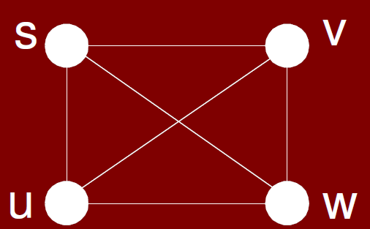
Motivational Example: Shortest path
We would like to find the shortest path from s to each other vertex in the graph
For each vertex v in V, we will store d[v] which is the distance (length of the shortest path) from s to v.
We will also store a predecessor (or parent) pointer ∏[v] which is the first vertex along the shortest path if we walk from v backwards to s.
There n choices for source node s,
(n − 1) choices for destination node,
(n − 2) for first hop (edge) in the path
(n − 3) for second
(n − 4) for third down to (n − (n − 1)) for last leg

Slide 5
Graph Traversal
Efficiency
  We must avoid visiting the same place repeatedly
Correctness
  The search must visit every node and every edge
Complete
  The search must be able to find a solution if there is any
Optimal
  The search should be able to find the best solution
Approaches
  Breadth-First Search (BFS)
  Depth-First Search (DFS)

Slide 6
Breadth-First Search
Given an initial vertex on the graph, the remaining vertex are discovered on a level by level basis
Queue-based algorithm
Define a tree on the vertices

Slide 7
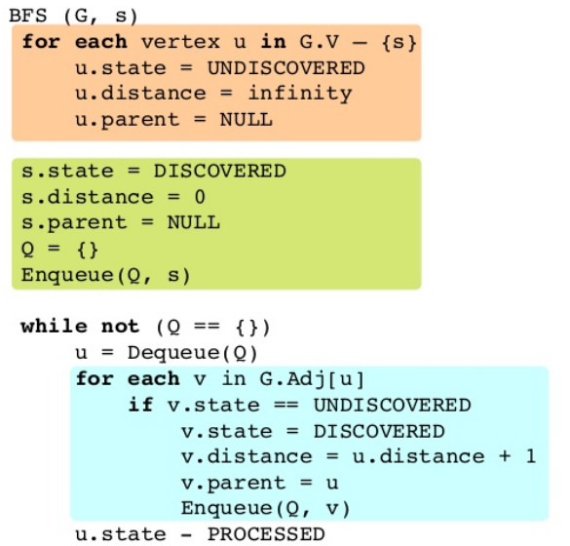
BFS Algorithm

Slide 8

BFS Example

Slide 9

BFS Example

Slide 10

BFS Example

Slide 11

BFS Example

Slide 12

BFS Example

Slide 13

BFS Example

Slide 14

BFS Example

Slide 15

BFS Example

Slide 16

BFS Example

Slide 17

BFS Example

Slide 18

BFS Example

Slide 19

BFS Example

Slide 20
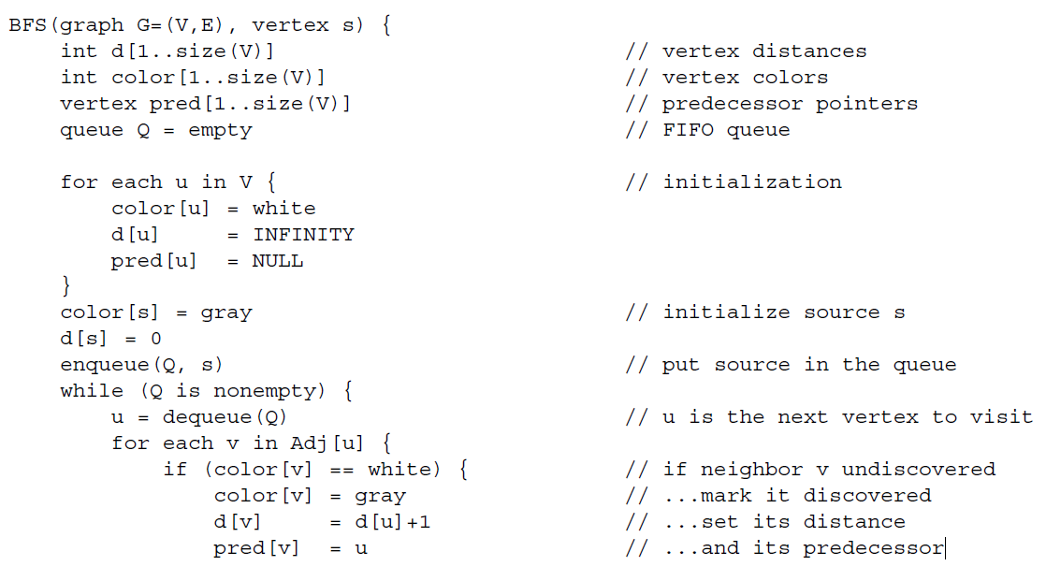


Slide 21
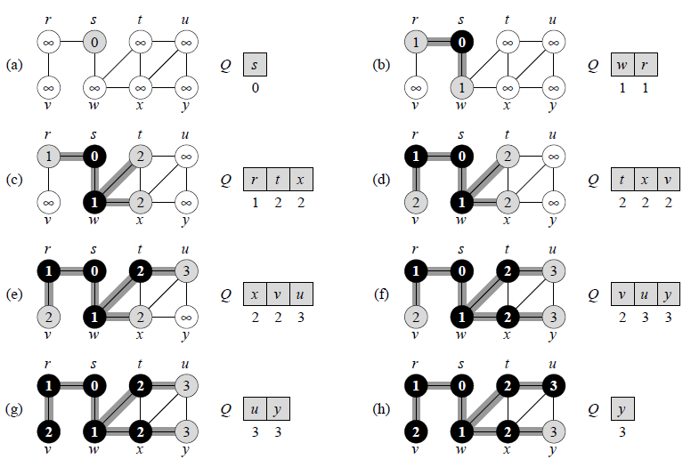
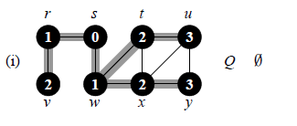

Slide 22
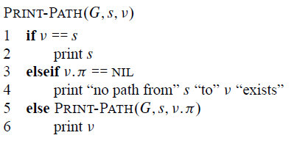

Slide 23
BFS Analysis
initialize : O(n)
Loop: Queue operations and Adjacency checks
Queue operations
  each vertex is enqueued/dequeued at most once. Why?
  each operation takes O(1) time, hence O(n)
Adjacency checks
  adjacency list of each vertex is scanned at most once
  sum of lengths of adjacency lists = O(e)
Total run time of BFS = O(n+e)

Slide 24
Breadth-First Search: Properties
What do we get the end of BFS?
d[v] = shortest-path distance from s to v, i.e. minimum number of edges from s to v, or ∞ if v not reachable from s
  Proof : refer CLRS
a breadth-first tree, in which path from root s to any vertex v represent a shortest path
  Thus can use BFS to calculate shortest path from one vertex to another in O(n+e) time, for unweighted graphs.

Slide 25
BFS Application
Shortest path from node x (start node) to y
Connected components
Two-coloring graph

Slide 26
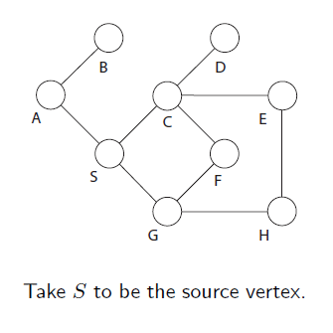
BFS Exercise

Slide 27
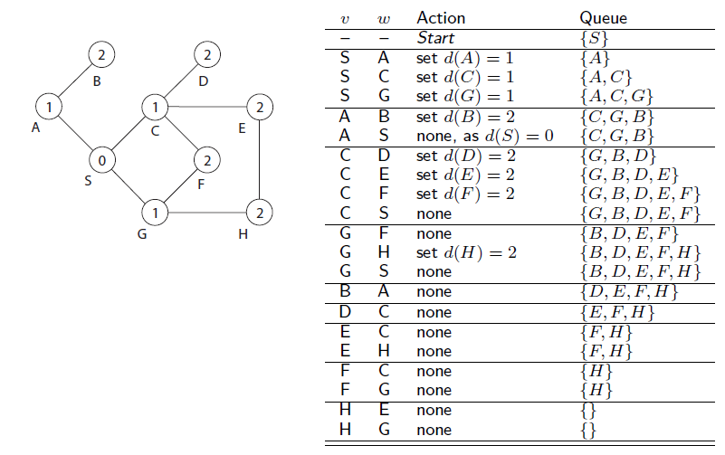
BFS Exercise Result

Slide 28
Depth-First Search (DFS)
Explore “deeper” in the graph whenever possible
  Edges are explored out of the most recently discovered vertex v that still has unexplored edges (LIFO)
  When all of v’s edges have been explored, backtrack to the vertex from which v was discovered
  Computes 2 timestamps: d[ ] (discovered) and f[ ] (finished)
  Builds one or more depth-first tree(s) (depth-first forest)
DFS is Stack-based algorithm

Slide 29
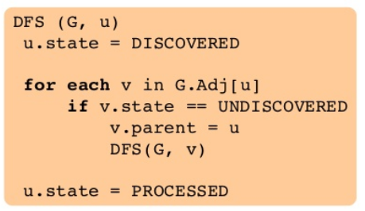
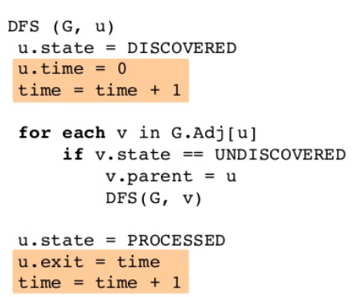
DFS Algorithm

Slide 30
DFS Algorithm with colors
Algorithm colors each vertex
  WHITE: undiscovered
  GRAY: discovered, in process
  BLACK: finished, all adjacent vertices have been discovered
  Note: Follow this pseudo-code
DFS_Visit(u)
{
  color[u] = GREY;
  time = time+1;
  d[u] = time; // compute d[]
  for each v adjacent to u
    if (color[v] == WHITE)
      p[v]= u // build tree
      DFS_Visit(v);
  color[u] = BLACK;
  time = time+1;
  f[u] = time; // compute f[]
}
DFS(G)
{
  for each vertex u V
    color[u] = WHITE;
  time = 0;
  for each vertex u in G
    if (color[u] == WHITE)
      DFS_Visit(u);
}

Slide 31
DFS Analysis
Running time of DFS = O(n+e)
DFS (excluding DFS_Visit) takes O(n) time
DFS_Visit:
  DFS_Visit( v ) is called exactly once for each vertex v
  During DFS_Visit( v ), adjacency list of v is scanned once
  Sum of lengths of adjacency lists = O(e)

Slide 32
DFS Application
Finding Cycles
Finding Articulation Vertices
Topological Sorting on DAG
Strongly Connected Components

Slide 33
DFS Classification of Edges
DFS can be used to classify edges of G:
  Tree edges: edges in the depth-first forest.
  Back edges: edges (u, v) connecting a vertex u to an ancestor v in a depth-first tree.
  Forward edges: non-tree edges (u, v) connecting a vertex u to a descendant v in a depth-first tree.
  Cross edges: all other edges.
DFS yields valuable information about the structure of a graph.

Slide 34
Operations of DFS
u
v
w
Undiscovered
Discovered, On Process
Finished, all adjacent vertices have been discovered
x
y
z
Discover time/ Finish time

Slide 35
Operations of DFS
u
u
v
v
w
w
Undiscovered
1/
Discovered, On Process
Finished, all adjacent vertices have been discovered
x
x
y
y
z
z
Discover time/ Finish time

Slide 36
Operations of DFS
u
u
u
v
v
v
w
w
w
Undiscovered
1/
1/
2/
Discovered, On Process
Finished, all adjacent vertices have been discovered
x
y
z
x
x
y
y
z
z
Tree edge
Discover time/ Finish time

Slide 37
Operations of DFS
u
u
u
u
v
v
v
v
w
w
w
w
Undiscovered
1/
1/
1/
2/
2/
Discovered, On Process
Finished, all adjacent vertices have been discovered
3/
x
y
z
x
x
x
y
y
y
z
z
z
Tree edge
Discover time/ Finish time

Slide 38
Operations of DFS
u
u
u
u
u
u
v
v
v
v
v
v
w
w
w
w
w
w
Undiscovered
1/
1/
1/
1/
1/
2/
2/
2/
2/
Discovered, On Process
4/
3/
4/
3/
Finished, all adjacent vertices have been discovered
3/
x
y
z
x
y
z
x
x
x
x
y
y
y
y
z
z
z
z
Tree edge
Back Edge
Discover time/ Finish time

Slide 39
Operations of DFS
u
u
u
u
u
u
u
v
v
v
v
v
v
v
w
w
w
w
w
w
w
Undiscovered
1/
1/
1/
1/
1/
1/
2/
2/
2/
2/
2/
Discovered, On Process
4/
3/
4/
4/5
3/
3/
Finished, all adjacent vertices have been discovered
3/
x
y
z
x
y
z
x
x
x
x
x
y
y
y
y
y
z
z
z
z
z
Tree edge
Back Edge
Discover time/ Finish time

Slide 40
Operations of DFS
u
u
u
u
u
u
u
u
v
v
v
v
v
v
v
v
w
w
w
w
w
w
w
w
Undiscovered
1/
1/
1/
1/
1/
1/
1/
2/
2/
2/
2/
2/
2/
Discovered, On Process
4/
3/
4/
4/5
4/5
3/
3/
3/
Finished, all adjacent vertices have been discovered
3/6
x
y
z
x
y
z
x
x
x
x
x
x
y
y
y
y
y
y
z
z
z
z
z
z
Tree edge
Back Edge
Discover time/ Finish time

Slide 41
Operations of DFS
u
u
u
u
u
u
u
u
u
v
v
v
v
v
v
v
v
v
w
w
w
w
w
w
w
w
w
Undiscovered
1/
1/
1/
1/
1/
1/
1/
1/
2/
2/
2/
2/
2/
2/
2/7
Discovered, On Process
4/
3/
4/
4/5
4/5
4/5
3/
3/
3/
3/6
Finished, all adjacent vertices have been discovered
3/6
x
y
z
x
y
z
x
x
x
x
x
x
x
y
y
y
y
y
y
y
z
z
z
z
z
z
z
Tree edge
Back Edge
Discover time/ Finish time

Slide 42
Operations of DFS
u
u
u
u
u
u
u
u
u
u
u
v
v
v
v
v
v
v
v
v
v
v
w
w
w
w
w
w
w
w
w
w
w
Undiscovered
1/
1/
1/
1/
1/
1/
1/
1/
1/
1/8
2/
2/7
2/
2/
2/
2/
2/
2/7
2/7
Discovered, On Process
4/
3/
4/5
3/6
4/
4/5
4/5
4/5
4/5
3/
3/
3/
3/6
3/6
Finished, all adjacent vertices have been discovered
3/6
x
y
z
x
y
z
x
y
z
x
x
x
x
x
x
x
x
y
y
y
y
y
y
y
y
z
z
z
z
z
z
z
z
Tree edge
Back Edge
Discover time/ Finish time
Forward Edge

Slide 43
Operations of DFS
u
u
u
u
u
u
u
u
u
u
u
v
v
v
v
v
v
v
v
v
v
v
w
w
w
w
w
w
w
w
w
w
w
Undiscovered
1/
1/8
1/
1/
1/
1/
1/
1/
1/
1/8
2/
2/7
2/
2/
2/
2/
2/
2/7
2/7
Discovered, On Process
4/
3/
4/5
3/6
4/
4/5
4/5
4/5
4/5
3/
3/
3/
3/6
3/6
Finished, all adjacent vertices have been discovered
3/6
x
y
z
x
y
z
x
y
z
x
x
x
x
x
x
x
x
y
y
y
y
y
y
y
y
z
z
z
z
z
z
z
z
Tree edge
Back Edge
Discover time/ Finish time
Forward Edge

Slide 44
Operations of DFS
u
u
u
u
u
u
u
u
u
u
u
u
v
v
v
v
v
v
v
v
v
v
v
v
w
w
w
w
w
w
w
w
w
w
w
w
Undiscovered
1/
1/8
1/
1/
1/
1/
1/
1/
1/
1/8
1/8
2/
2/7
2/
2/
2/
2/
2/
2/7
2/7
2/7
9/
Discovered, On Process
4/
3/
4/5
3/6
4/
4/5
4/5
4/5
4/5
4/5
3/
3/
3/
3/6
3/6
3/6
Finished, all adjacent vertices have been discovered
3/6
x
y
z
x
y
z
x
y
z
x
x
x
x
x
x
x
x
x
y
y
y
y
y
y
y
y
y
z
z
z
z
z
z
z
z
z
Tree edge
Back Edge
Discover time/ Finish time
Forward Edge

Slide 45
Operations of DFS
u
u
u
u
u
u
u
u
u
u
u
u
u
v
v
v
v
v
v
v
v
v
v
v
v
v
w
w
w
w
w
w
w
w
w
w
w
w
w
Undiscovered
1/
1/8
1/
1/8
1/
1/
1/
1/
1/
1/
1/8
1/8
2/
2/7
2/
2/7
2/
2/
2/
2/
2/7
2/7
2/7
9/
9/
Discovered, On Process
4/
3/
4/5
3/6
4/5
3/6
4/
4/5
4/5
4/5
4/5
4/5
3/
3/
3/
3/6
3/6
3/6
Finished, all adjacent vertices have been discovered
3/6
x
y
z
x
y
z
x
y
z
x
y
z
x
x
x
x
x
x
x
x
x
y
y
y
y
y
y
y
y
y
z
z
z
z
z
z
z
z
z
Tree edge
Back Edge
Discover time/ Finish time
Forward Edge
Cross Edge

Slide 46
Operations of DFS
u
u
u
u
u
u
u
u
u
u
u
u
u
u
v
v
v
v
v
v
v
v
v
v
v
v
v
v
w
w
w
w
w
w
w
w
w
w
w
w
w
w
Undiscovered
1/
1/8
1/
1/8
1/
1/
1/
1/
1/
1/
1/8
1/8
1/8
2/
2/7
2/
2/7
2/
2/
2/
2/
2/7
2/7
2/7
2/7
9/
9/
9/
Discovered, On Process
4/
3/
4/5
3/6
4/5
3/6
4/
4/5
4/5
4/5
4/5
4/5
4/5
3/
3/
3/
3/6
3/6
3/6
3/6
Finished, all adjacent vertices have been discovered
3/6
10/
x
y
z
x
y
z
x
y
z
x
y
z
x
x
x
x
x
x
x
x
x
x
y
y
y
y
y
y
y
y
y
y
z
z
z
z
z
z
z
z
z
z
Tree edge
Back Edge
Discover time/ Finish time
Forward Edge
Cross Edge

Slide 47
Operations of DFS
u
u
u
u
u
u
u
u
u
u
u
u
u
u
u
v
v
v
v
v
v
v
v
v
v
v
v
v
v
v
w
w
w
w
w
w
w
w
w
w
w
w
w
w
w
Undiscovered
1/
1/8
1/
1/8
1/8
1/
1/
1/
1/
1/
1/
1/8
1/8
1/8
2/
2/7
2/
2/7
2/7
2/
2/
2/
2/
2/7
2/7
2/7
2/7
9/
9/
9/
9/
Discovered, On Process
4/
3/
4/5
3/6
4/5
3/6
4/
4/5
4/5
4/5
4/5
4/5
4/5
4/5
3/6
3/
3/
3/
3/6
3/6
3/6
3/6
3/6
10/
Finished, all adjacent vertices have been discovered
10/
x
y
z
x
y
z
x
y
z
x
y
z
x
x
x
x
x
x
x
x
x
x
x
y
y
y
y
y
y
y
y
y
y
y
z
z
z
z
z
z
z
z
z
z
z
Tree edge
Back Edge
Discover time/ Finish time
Forward Edge
Cross Edge

Slide 48
Operations of DFS
u
u
u
u
u
u
u
u
u
u
u
u
u
u
u
u
v
v
v
v
v
v
v
v
v
v
v
v
v
v
v
v
w
w
w
w
w
w
w
w
w
w
w
w
w
w
w
w
Undiscovered
1/
1/8
1/
1/8
1/8
1/8
1/
1/
1/
1/
1/
1/
1/8
1/8
1/8
2/
2/7
2/
2/7
2/7
2/7
2/
2/
2/
2/
2/7
2/7
2/7
2/7
9/
9/
9/
9/
9/
Discovered, On Process
4/
3/
4/5
3/6
4/5
3/6
4/
4/5
4/5
4/5
4/5
4/5
4/5
4/5
4/5
3/6
3/6
3/
3/
3/
3/6
3/6
3/6
3/6
3/6
10/
10/11
Finished, all adjacent vertices have been discovered
10/
x
y
z
x
y
z
x
y
z
x
y
z
x
x
x
x
x
x
x
x
x
x
x
x
y
y
y
y
y
y
y
y
y
y
y
y
z
z
z
z
z
z
z
z
z
z
z
z
Tree edge
Back Edge
Discover time/ Finish time
Forward Edge
Cross Edge

Slide 49
Operations of DFS
u
u
u
u
u
u
u
u
u
u
u
u
u
u
u
u
u
v
v
v
v
v
v
v
v
v
v
v
v
v
v
v
v
v
w
w
w
w
w
w
w
w
w
w
w
w
w
w
w
w
w
Undiscovered
1/
1/8
1/
1/8
1/8
1/8
1/8
1/
1/
1/
1/
1/
1/
1/8
1/8
1/8
2/
2/7
2/
2/7
2/7
2/7
2/7
2/
2/
2/
2/
2/7
2/7
2/7
2/7
9/
9/
9/
9/12
9/
9/
Discovered, On Process
4/
3/
4/5
3/6
4/5
3/6
4/
4/5
4/5
4/5
4/5
4/5
4/5
4/5
4/5
4/5
3/6
3/6
3/6
3/
3/
3/
3/6
3/6
3/6
3/6
3/6
10/
10/11
10/11
Finished, all adjacent vertices have been discovered
10/
x
y
z
x
y
z
x
y
z
x
y
z
x
x
x
x
x
x
x
x
x
x
x
x
x
y
y
y
y
y
y
y
y
y
y
y
y
y
z
z
z
z
z
z
z
z
z
z
z
z
z
Tree edge
Back Edge
Discover time/ Finish time
Forward Edge
Cross Edge

Slide 50
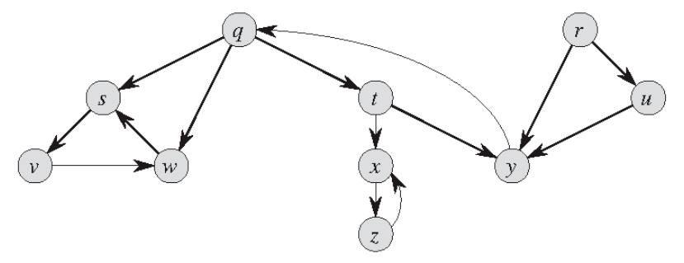
DFS Exercise

Slide 51
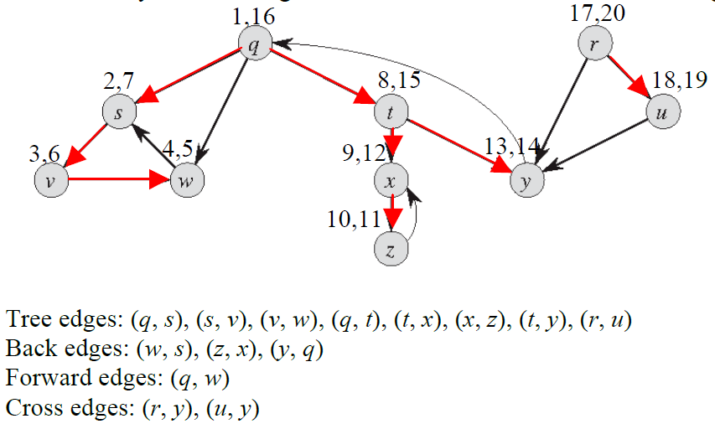
DFS Exercise Solution

Slide 52
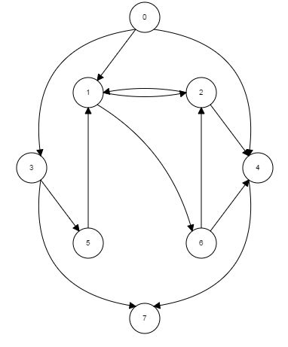
DFS Exercise

Slide 53
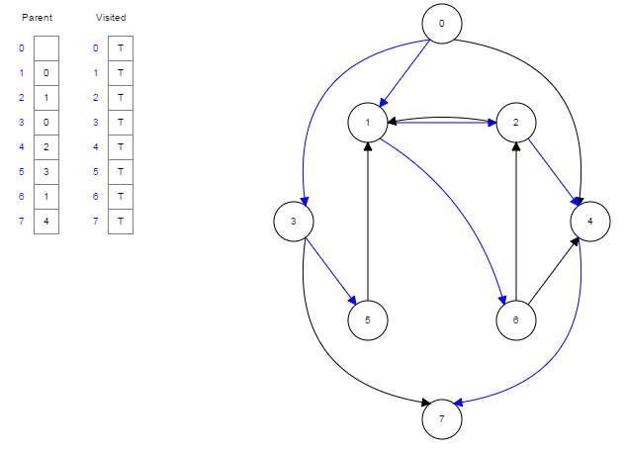
DFS Exercise Solution

Slide 54
Cycle Detection
Theorem: An undirected graph is acyclic iff a DFS yields no back edges
Proof
  If acyclic, no back edges by definition (because a back edge implies a cycle)
  If no back edges, acyclic
    No back edges implies only tree edges (Why?)
    Only tree edges implies we have a tree or a forest
    Which by definition is acyclic
Thus, can run DFS to find whether a graph has a cycle.
How would you modify the code to detect cycles?

Slide 55
Directed Acyclic Graph (DAG)
Arises in many applications where there are precedence or ordering constraints (e.g. scheduling problems)
  if there are a series of tasks to be performed, and certain tasks must precede other tasks
In general, a precedence constraint graph is a DAG, in which vertices are tasks and edge (u, v) means that task u must be completed before task v begins

Slide 56
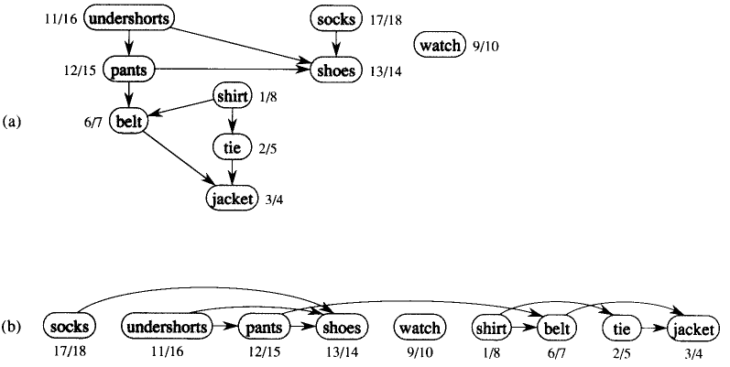
Topological Ordering

Slide 57
Topological Sort
Find a linear ordering of all vertices of the DAG such that if G contains an edge (u, v), u appears before v in the ordering.
In general, there may be many legal topological orders for a given DAG.
Idea:
  Call DFS(G) to compute finishing time f[ ]
  Insert vertices onto a linked list according to decreasing order of f[ ]
How to modify DFS to perform Topological Sort in O(n+e) time?

Slide 58
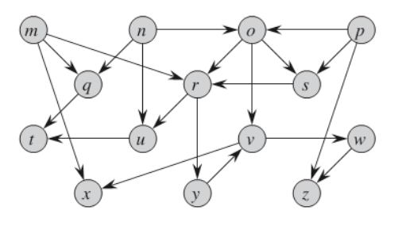
Topological Sort Exercise

Slide 59
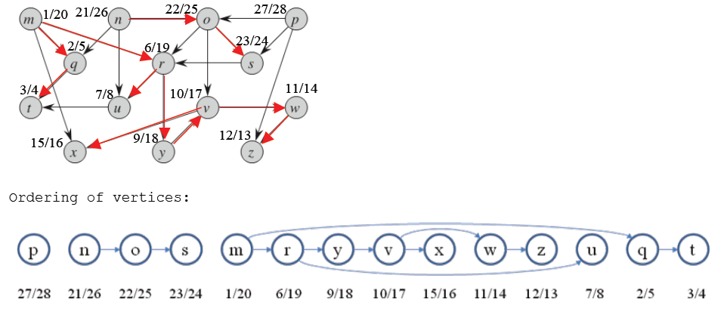
Topological Sort Exercise Solution

Slide 60
Strongly Connected Components
A graph is said to be strongly connected if every vertex is reachable from every other vertex
The strongly connected components of an arbitrary directed graph form a partition into sub-graphs that are themselves strongly connected.
Digraphs are often used to model communication and transportation networks
People want to know that the networks are complete in the sense that from any location it is possible to reach another location in the digraph
How to find strongly connected components (SCC) of a digraph?

Slide 61

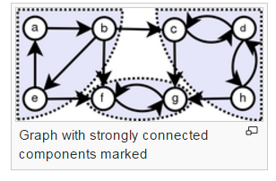
Strongly Connected Components

Slide 62

Algorithm (SCC)
Strongly-Connected-Components(G)
  call DFS(G) to compute finish times f[]
  compute G^{T}
  call DFS(G^{T}) and consider vertices in decreasing f[] computed in step 1
  output vertices of each tree in DFS(GT) as separate strongly connected component
Total running time ΘT(n + e)

Slide 63
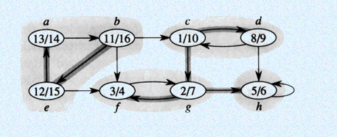
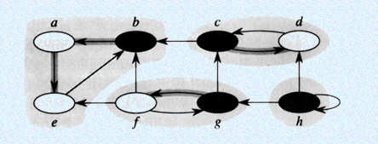
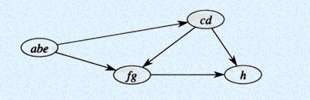
Strongly Connected Component

Slide 64
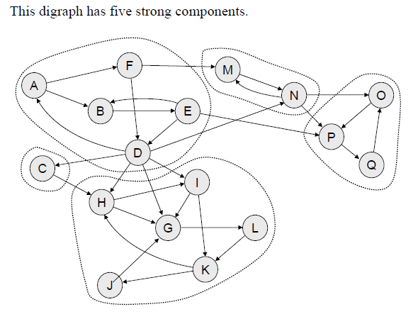
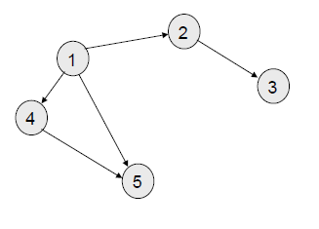
Strongly Connected Components

